Slide 1
MOVIE RECOMMENDATION SYSTEM
Title of the Project : Movie Recommendation System using Data science
Presented By : T. Raja Poojitha
Under the guidance of : Dr. A. Tirupataiah (Associate Professor)

Slide 2
PROBLEM STATEMENT
Aim: To build a movie recommendation system based on ‘Kaggle’ dataset using Data science.
We wish to integrate the aspects of personalization of user with the overall features of movie such as genre, popularity etc.
The goal of the project is to recommend a movie to the user on the bases of rating,genre using cosine similarity.
Providing related content out of relevant and irrelevant collection of items to users of online service providers.

Slide 3
INTRODUCTION
A recommendation system is a model used for information filtering where it tries to predict the preferences of a user and provide suggests based on these preferences.
Movie Recommendation Systems helps us to search our preffered movies among all of these different types of movies and hence reduce the trouble of spending a lot of searching our favourable movies.
Recommendation systems have several benefits, the important being customer satisfaction and revenue.

Slide 4
OBJECTIVE
The goal of our project is to develop a movie recommendation system for binge watchers to help and recommend them good quality of movies.
The Objectives are:
Improving the Accuracy of the recommendation system
Improve the quality of the movie Recommendation syatem
Improve the Scalability.
Enhancing the user experience.

Slide 5
TECHNOLOGIES USED
Programming Languages:
Python
Libraries and Frameworks:
Numpy, Pandas, Scikit-learn, Matplotlib, Seaborn
Tools:
Jupyter Notebook, Google colab

Slide 6
Types of Recommendation System
The recommendation syatem maily classified into two types
Content-Based Filtering
Collaborative Based Filtering
Content-Based Filtering
Content-based filtering is a recommadation system that suggests items to users based on their preferences and past behavior.

Slide 7
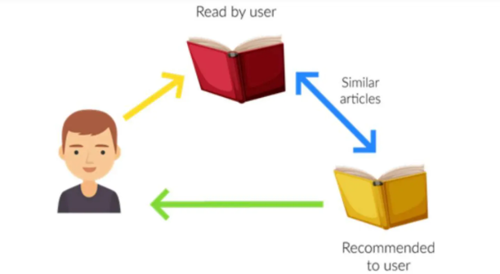
Content-Based Filtering:

Slide 8
Collabarative-Based Filtering:
Collaborative filtering is a recommendation system that makes suggestions based on the preferences and behaviors of multiple users.
There are two main types of collaborative filtering
User-User:- User-user collaborative filtering identifies similar users based on their past with items and recommends items that those similar users have interacted with.
Item-item:- Item-item collaborative filtering identifies similar items based on their interactions with users and recommends those items to a user who has interacted with similar items in the past.

Slide 9
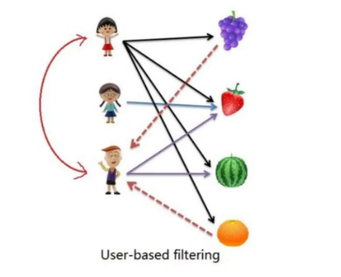
User-Based Collaborative Filtering

Slide 10
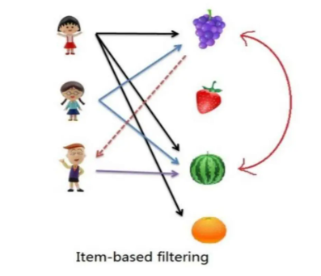
Item-Based Collaborative Filtering

Slide 11
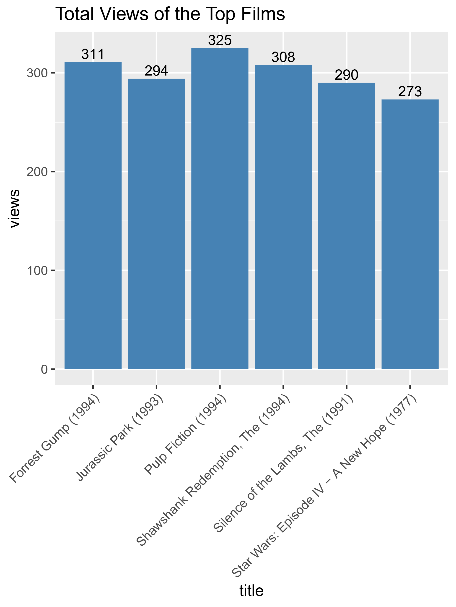
Total views of the top films:
From the visualisation, it could be observed that 'Pulp Fiction' is the most watched film followed by 'Forrest Gump'.

Slide 12
Key Benefits
Provides relevant content to user.
It saves time and money.
It increases customer engagement.
Specially designed for binge watchers.

Slide 13
Conclusion
In this project, to improve the accuracy, quality and scalability of movie recommendation system.
A Hybrid approach by unifying content based filtering and collaborative filtering using Singualr Value Decomposition (SVD) as a classifier.
The Proposed system will recommends good movies according to user’s choice.
Bring interests and make users happy.

Slide 14

Thank you

